Slide 1
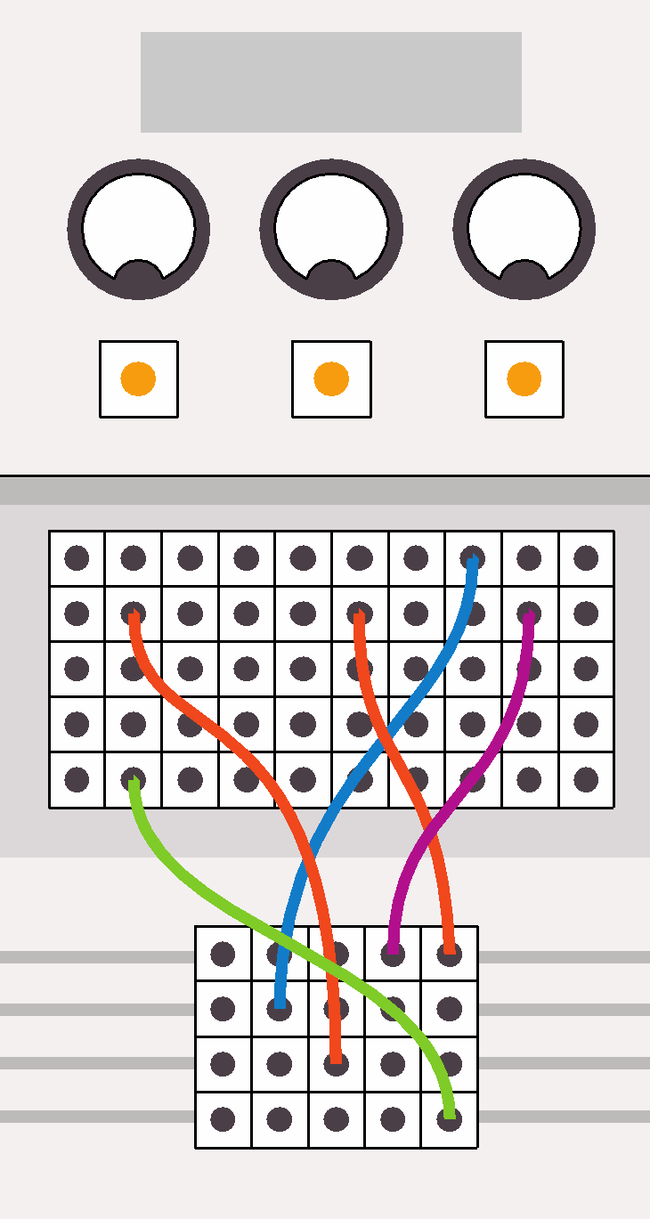
Computing:
past, present and future
Lesson 4: The history of computing

Slide 2
Objectives
In this lesson, you will learn:
about important figures in the development of computing
how to use a range of presentation software tools
how to create a well-designed presentation using presentation software.

Slide 3

Activity 4.1:
Word-processing software or presentation software?
Complete Quiz 4.1

Slide 4
Activity 4.2: Examples of good or bad design?
You are going to look at five slides from a presentation about the history of computing.
For each slide, identify examples of good and bad design.
DO NOW

Slide 5
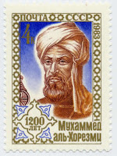
al-Khwarizmi (780–850 AD)
Known as the father of algebra, al-Khwarizmi was an outstanding Persian mathematician and one of the first Directors of the House of Wisdom in Baghdad in the early ninth century.
He oversaw the translation of important Greek and Indian books about mathematics and astronomy into Arabic.
The word ‘algorithm’ is derived from his name.
A stamp bearing the image of al-Khwarizmi.
Notes:
This is a very well-designed slide. There is a good balance of text and images and the image links closely to the text. The image has a caption and a credit, and the text is well spaced and in a readable font and at a readable font size. The theme used for the slide is engaging but not distracting. A good presentation will use the same theme for all slides.

Slide 6
Alan Turing
In 1936, the mathematician, Alan Turing, wrote a mathematics paper, ‘On Computable Numbers, with an Application to the Entscheidungsproblem’, which came to be seen as a theoretical basis for today’s computers. In his paper, Turing imagined a single machine that could compute any problem, effectively uniting all human or problem-specific ‘computers’ into one universal device.
Bletchley Park
When Turing was invited to Bletchley Park during the Second World War to join a team of code breakers put together to crack Nazi military codes, he got a chance to put some of his theories into practice. Working with Flowers and Newman, they built Colossus, the first model of a general-purpose computer. After the war, Turing went on to build the Pilot ACE, one of Britain’s earliest stored program computers and the oldest complete general purpose electronic computer in Britain.
By the mid-1950s, the computers imagined by Turing started to be built in real life and were becoming common in large institutions, companies and university departments. Such early machines, like the Pilot ACE and EDVAC were so enormous that they filled large rooms and they required a team of people to operate them.
Alan Turing is now celebrated as the inventor of the modern electronic computer and is considered to be the single most important figure in the history of computing.
Notes:
This slide is poorly designed. It contains far too much text and no images. It uses too many different fonts at different font sizes. It seems to rely on different coloured fonts to make the slide look attractive, but this just makes it hard to read, as does the poor contrast between the colours of the text and the colour of the background. The animation is overly complicated and makes it really hard to take in the information. The information is also too complicated for the intended audience.

Slide 7
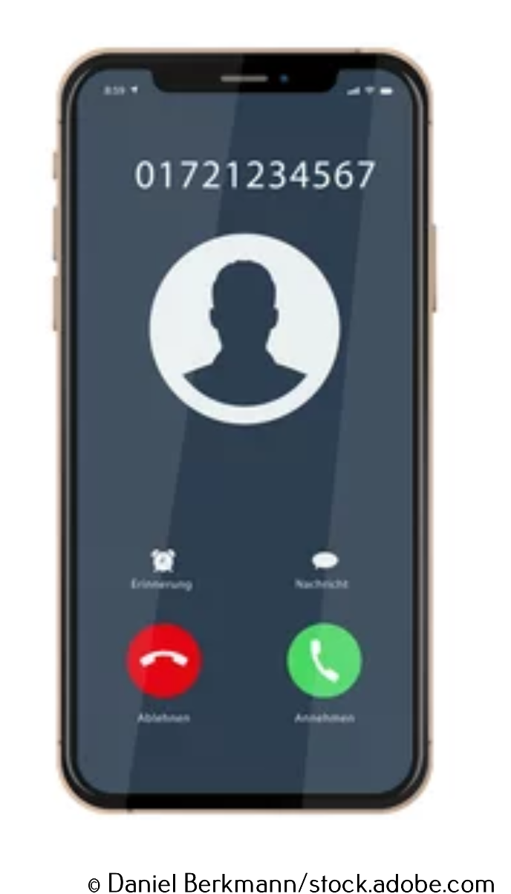
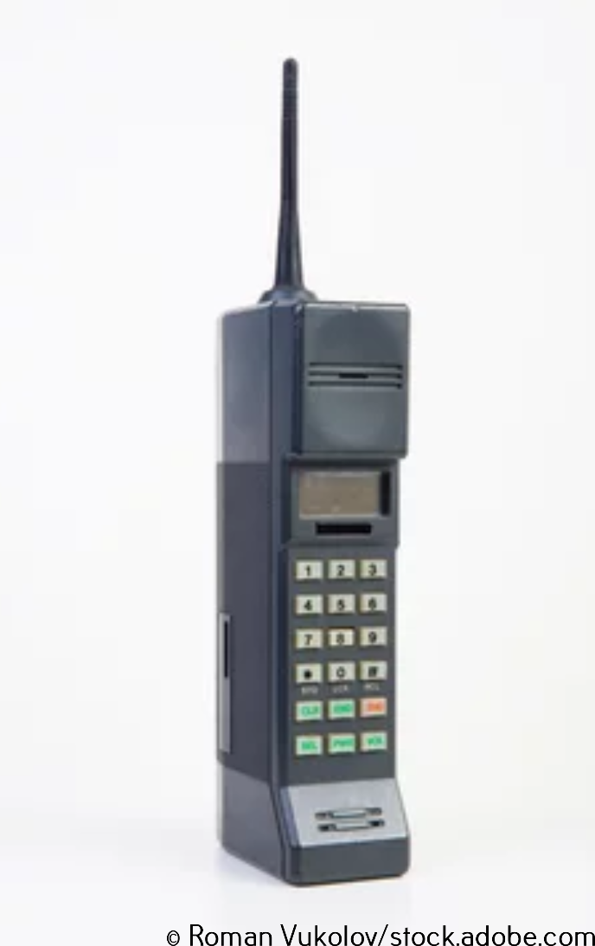
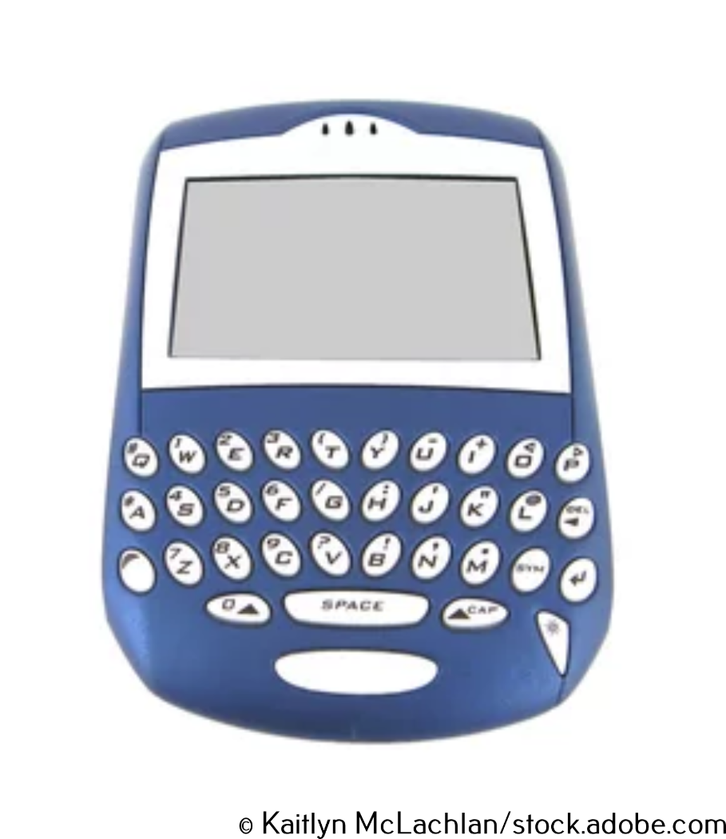
Notes:
This slide uses the same theme as Slide 5 and some may think it is a well-designed slide and some may think it is a poorly-designed slide. It all depends on how it is presented. A slide that contains only images can enhance a presentation if the presenter has a reason for including the slide in the deck and talks about the images, but it can be a waste of space if it doesn't have a clear purpose. Notice that all the images have credits.

Slide 8
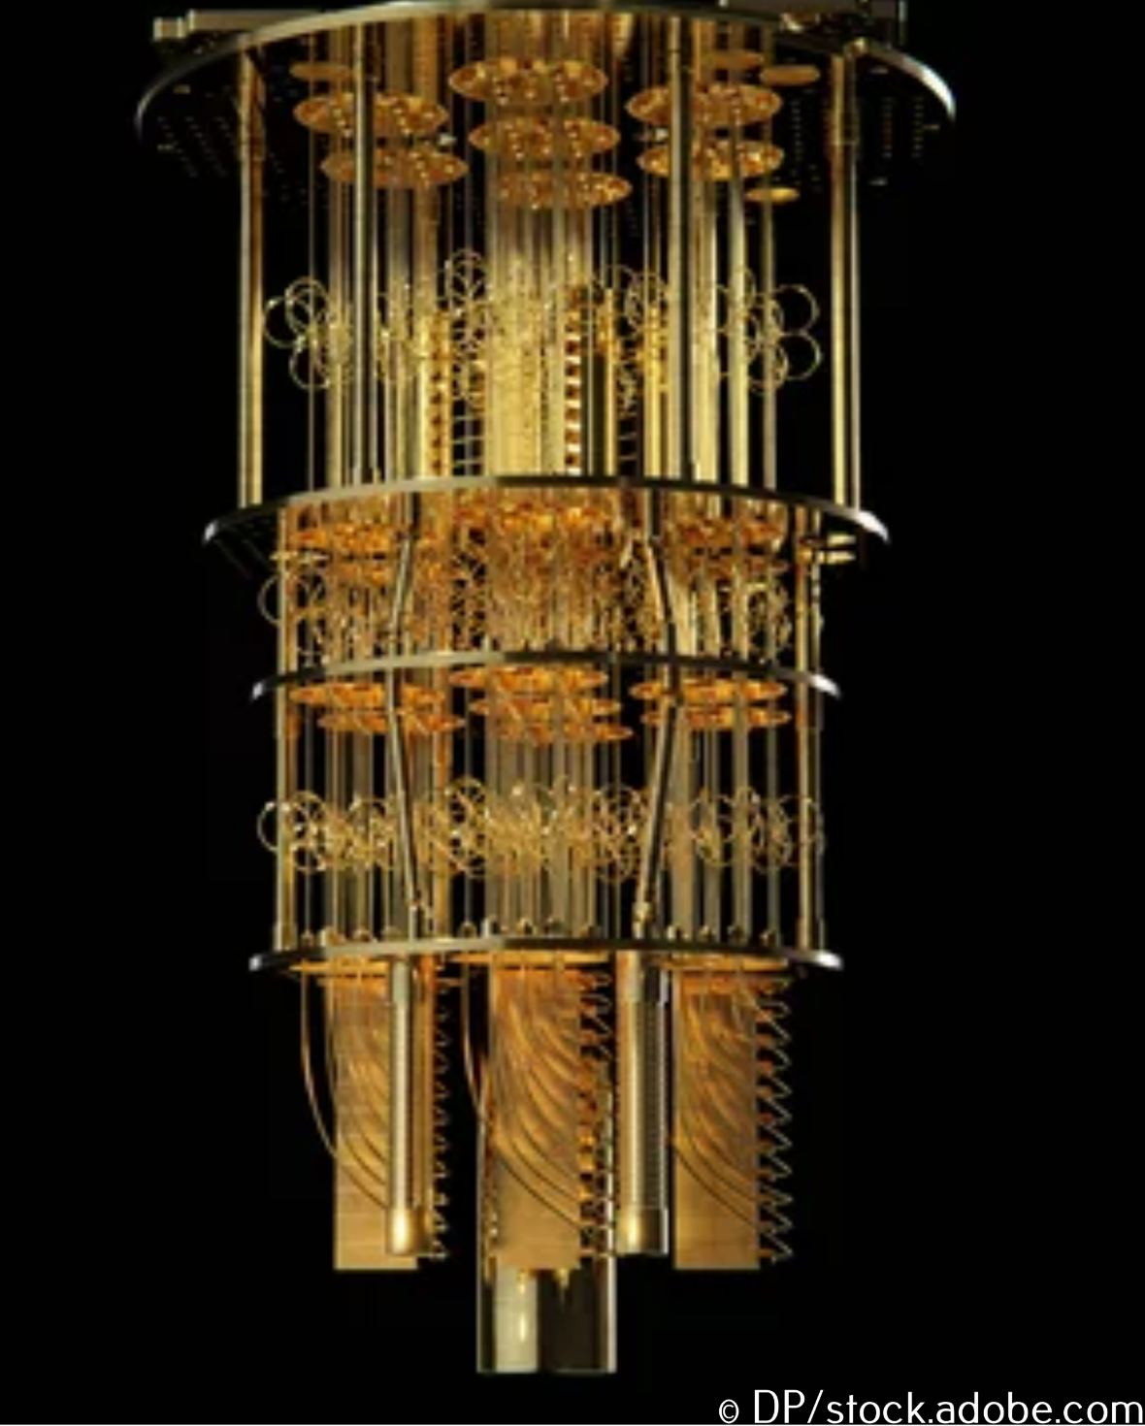
Quantum computing
Computer scientists are investigating completely new methods of computation, such as quantum computing.
The computer shown uses the spin property of electrons so that individual electrons are procesing and storing date.
This means that a single atom can store many pieces of data, opening the door for infinite parallel processing.
A quantum computer
Notes:
This is a well-designed slide that uses the same theme as Slide 5. Notice that the key words are in bold and that the animations help the audience take in one piece of information at a time. Unfortunately, it contains spelling mistakes and has clearly not been proofread properly. The photo has a credit and a caption.

Slide 9
The qualities of a well-designed presentation
The presentation has a title and most slides have headings.
The same approach to design is used throughout the presentation.
The number of fonts, font sizes and font colours is limited; too many can be confusing.
Animations add to the audience’s understanding not detract from it.
There is a strong contrast between the background colour(s) and the font colour(s).
There is a good balance between text and images and slides are not overcrowded.
Images relate to the text, can be seen clearly and have credits.
Audio and video clips should be embedded into the presentation; avoid linking to clips in another software application.

Slide 10
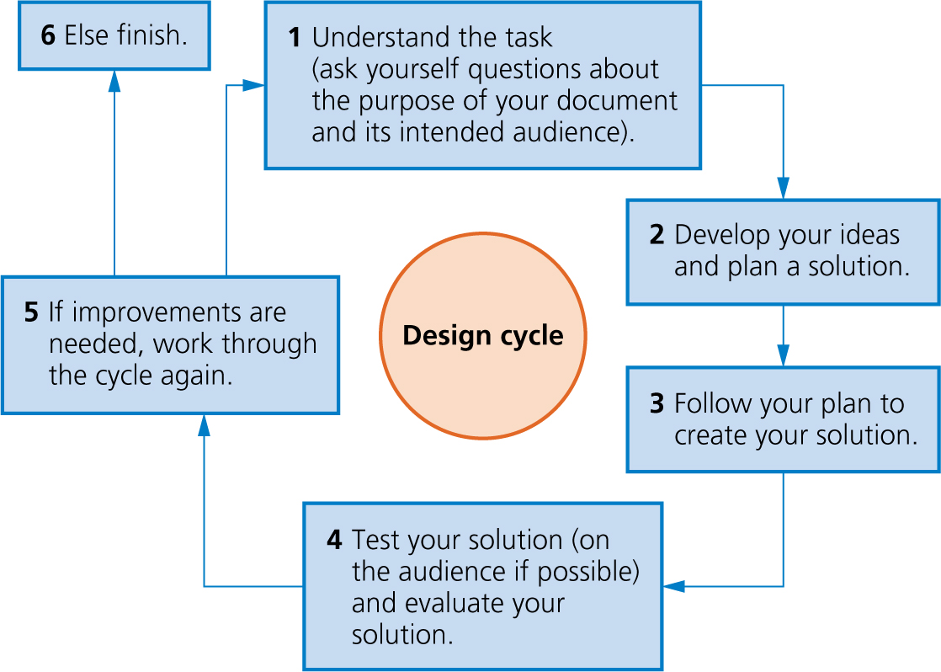
The design cycle

Slide 11
Activity 4.3:
A presentation about the history of computing

Slide 12
Activity 4.4:
Commenting on another presentation
Look at someone else’s presentation and use the comments tool to give feedback on the design of your partner’s report.
In PowerPoint, click on ‘Review’ and ‘New comment’.
In Google Slides, click on the ‘Add comment’ icon in the toolbar.
Remember to save your partner’s document when you have finished adding your comments.

Slide 13
Quiz 3

Slide 14
Activity 4.5: Finishing your presentation
Evaluate the feedback you received on your presentation and make improvements.
Remember to ‘Save as’ before you begin making improvements, so you always have the comments you received to refer back to.

